Slide 1
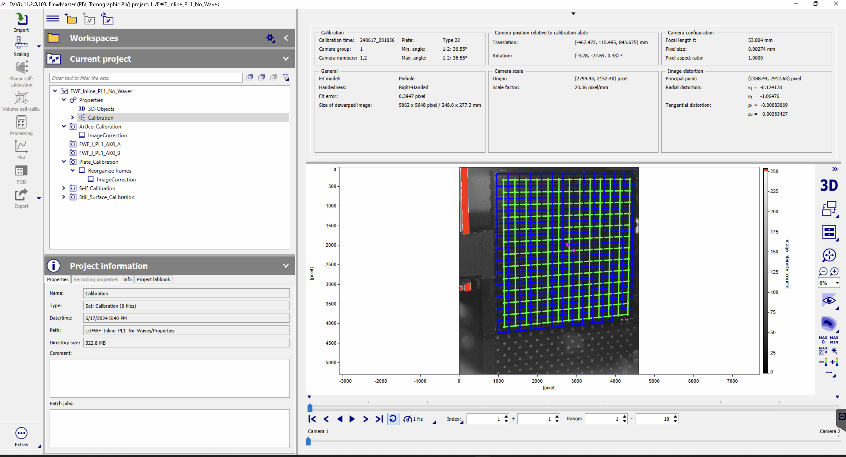
Plane 1

Slide 2
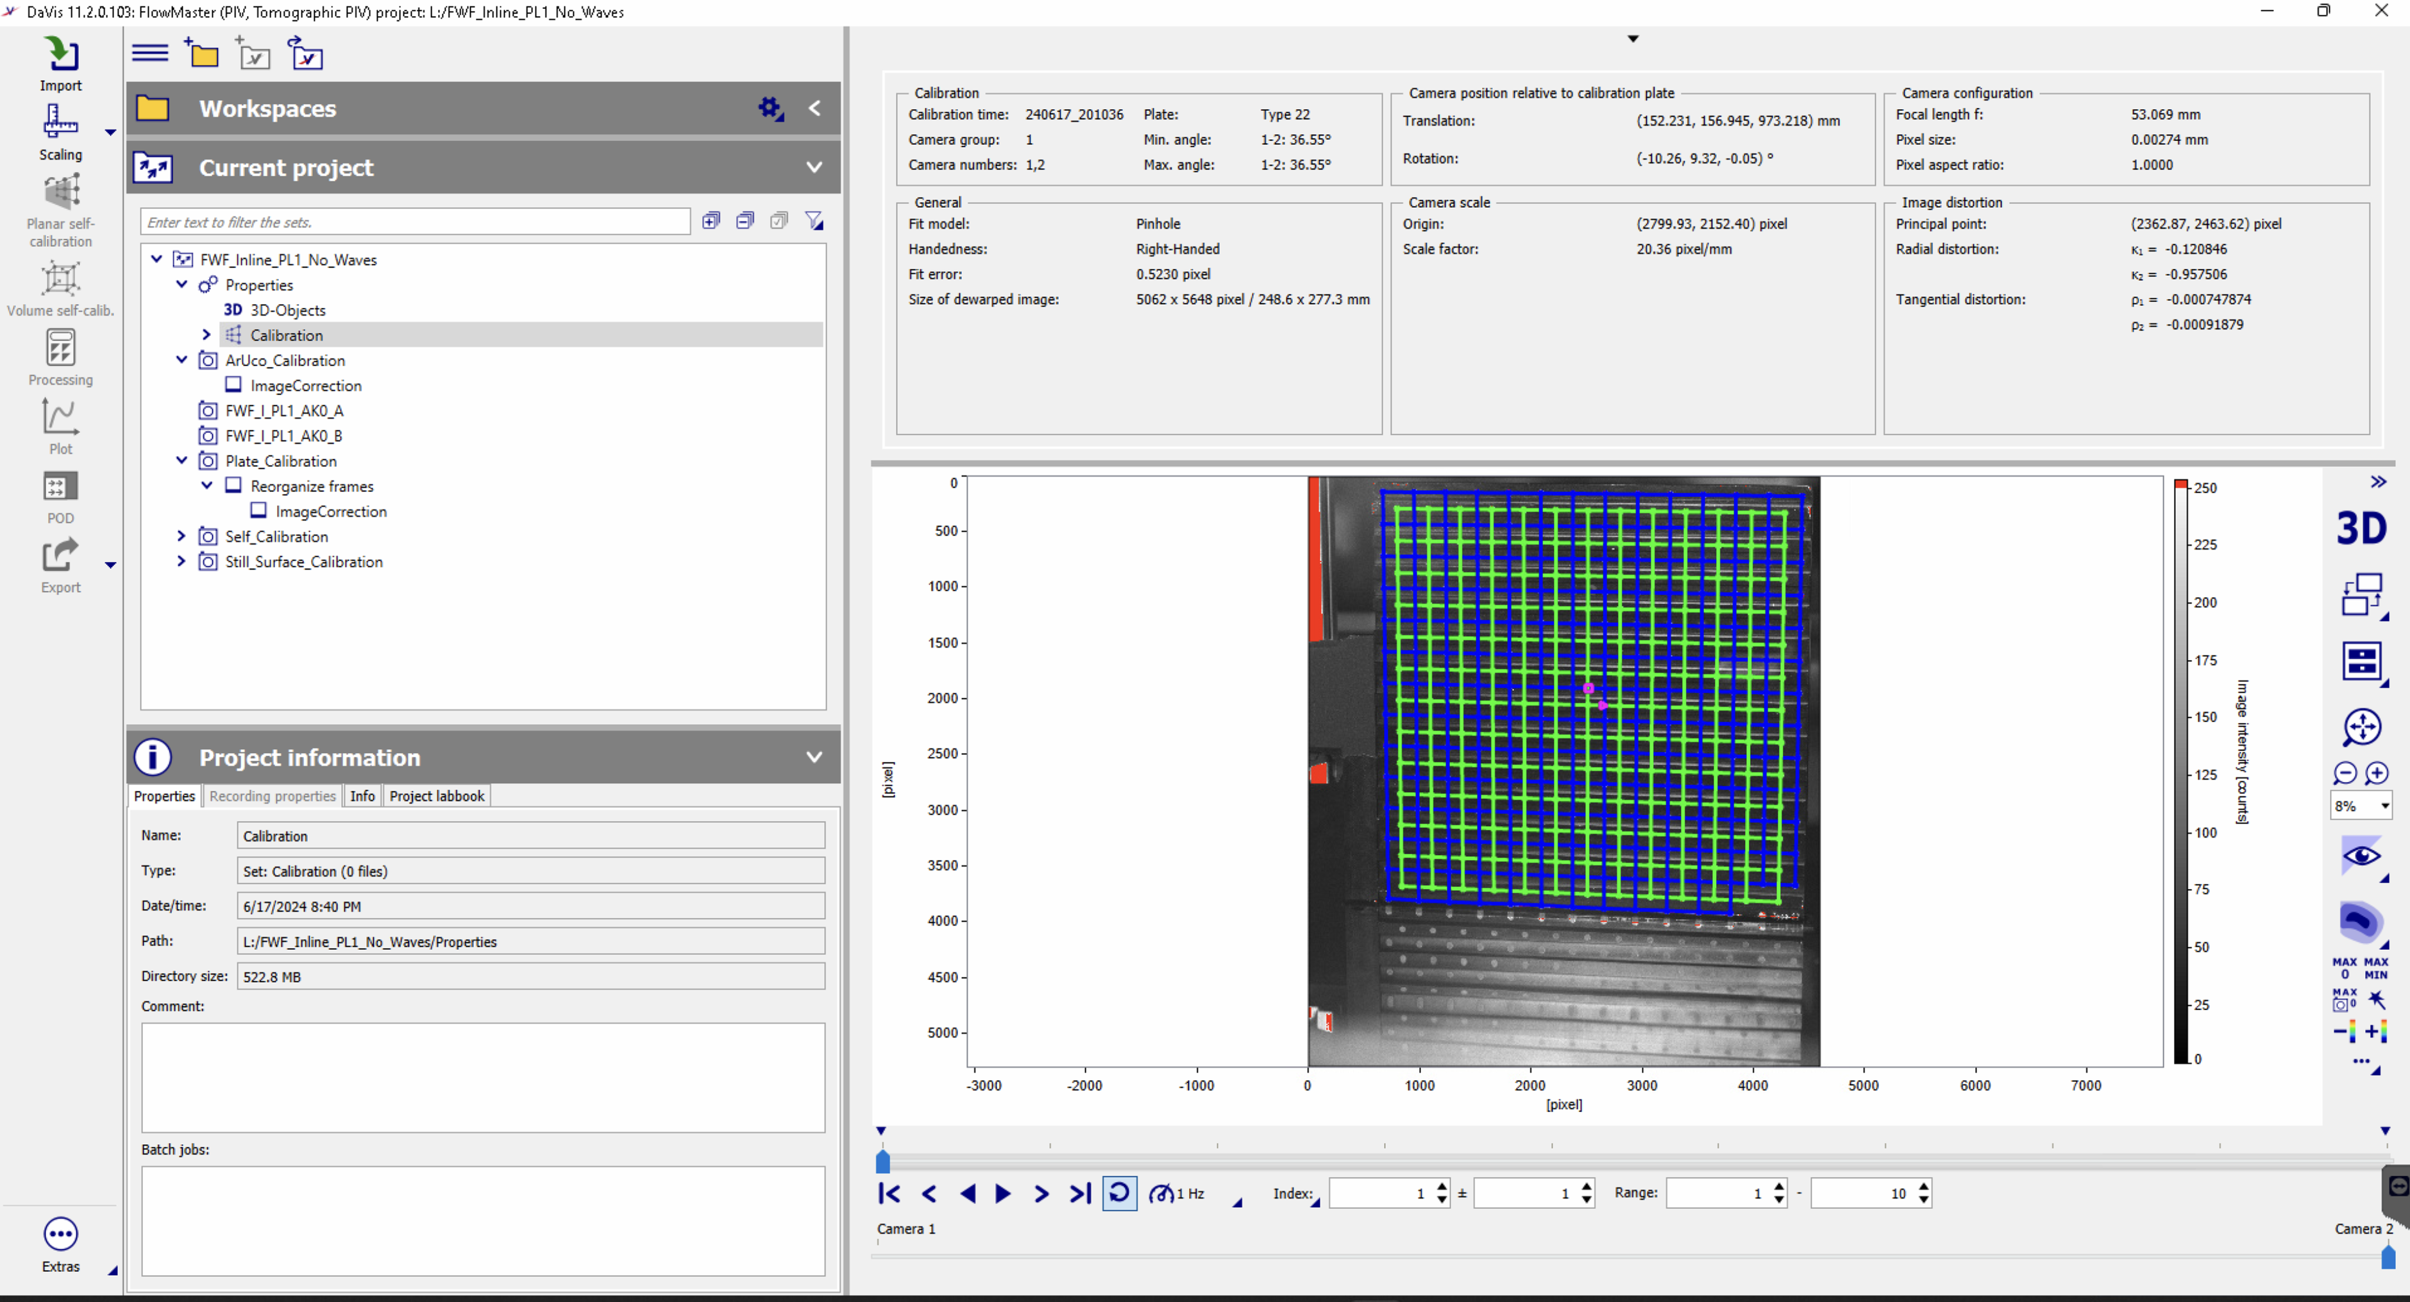
Plane 1

Slide 3
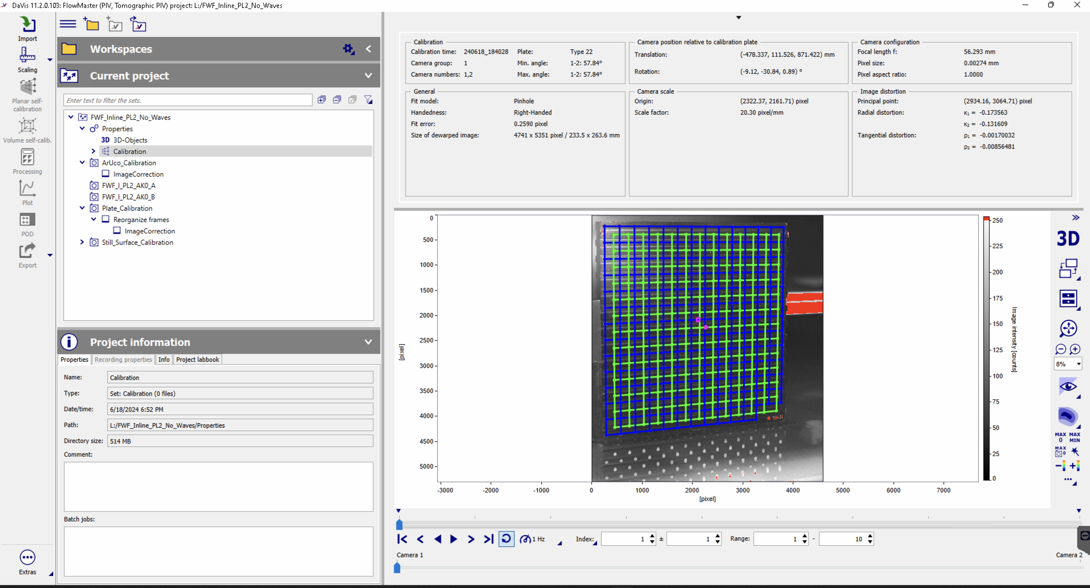
Plane 2

Slide 4
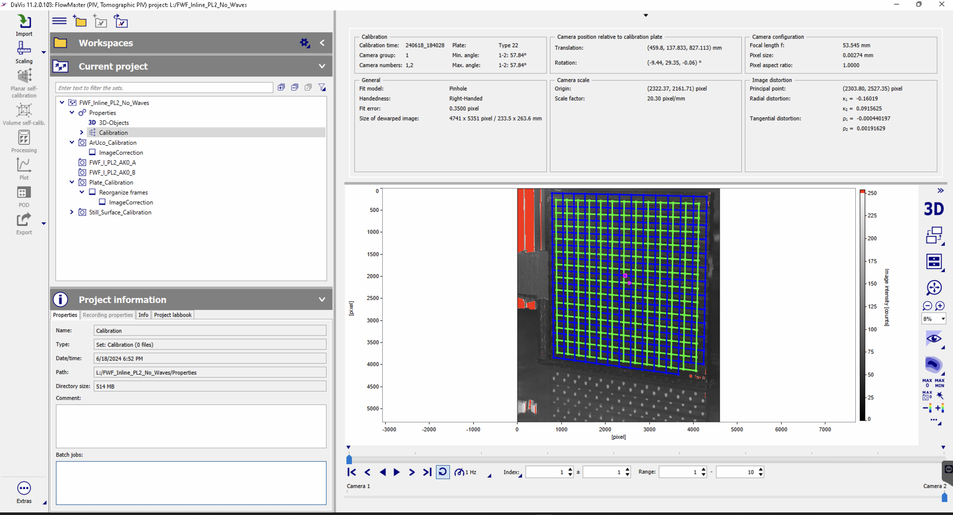
Plane 2

Slide 5
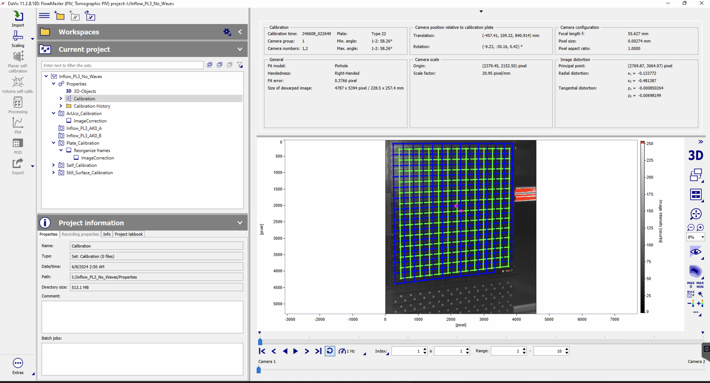
Plane 3

Slide 6

Plane 3

Slide 7
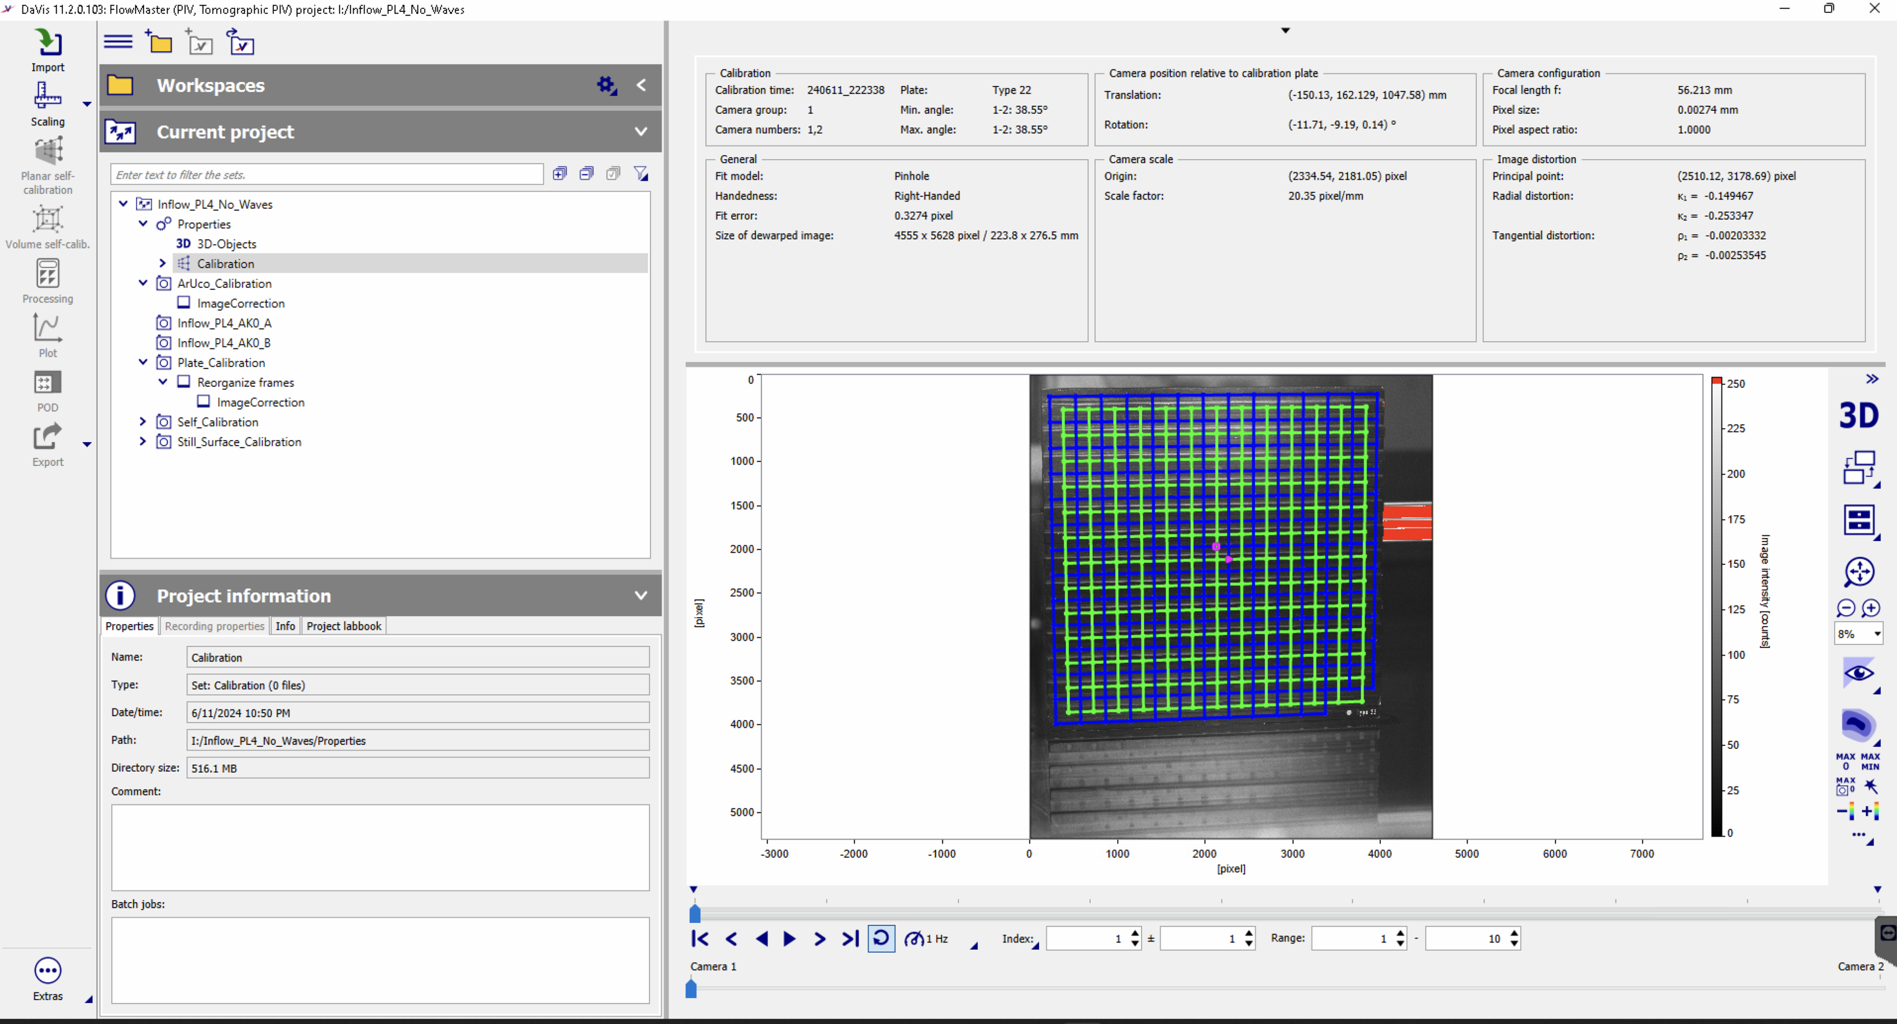
Plane 4

Slide 8
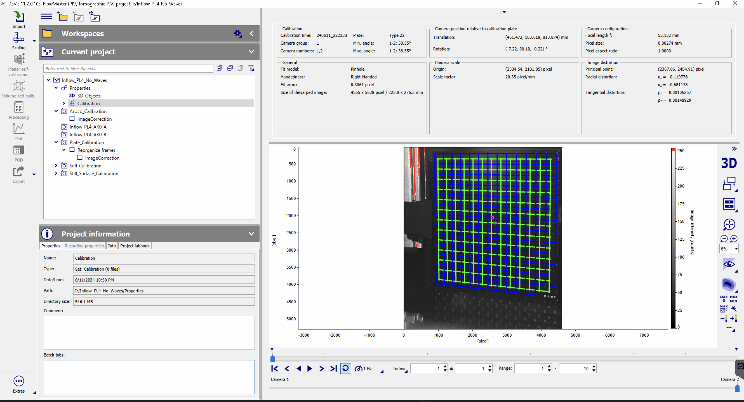
Plane 4

Slide 9
Camera arrangement and naming, consistent for all XY planes
Plate
CAM 1
CAM 2

